Slide 1
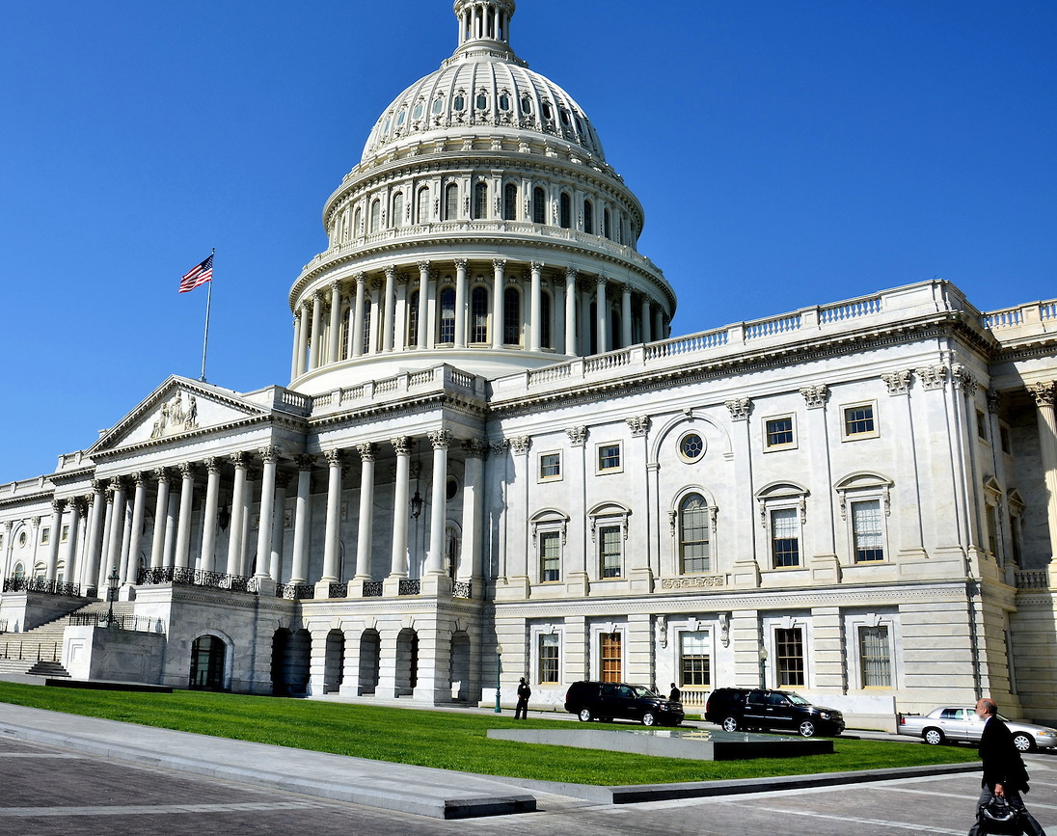
Predict the Flip!
A U.S. Senate Election Analysis
By Darius Fuller
Image copyright: © 2014 Richard F. Ebert All Rights Reserved

Slide 2
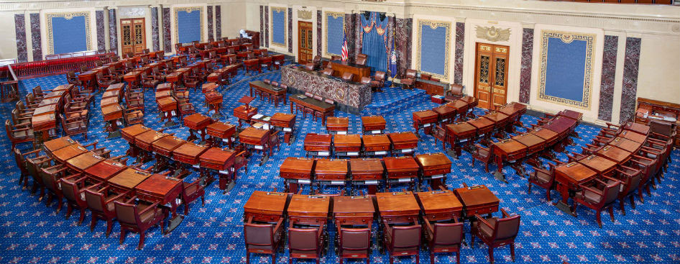
The Task & Goals
Tasks:
Make supervised machine learning model
Free, public information
Available from the internet
Goals:
Predict the winner of a senate general election
Gather insights for prospective candidates
Modeling results
EDA
Part of a larger machine

Slide 3

The Dataset
What:
Candidates in senate general elections
1920-2016
5,588 datapoints
8 total features
How:
‘Web scraping’
BeautifulSoup package
Pandas package
Genderize.io
Notes:
https://www.crummy.com/software/BeautifulSoup/

Slide 4
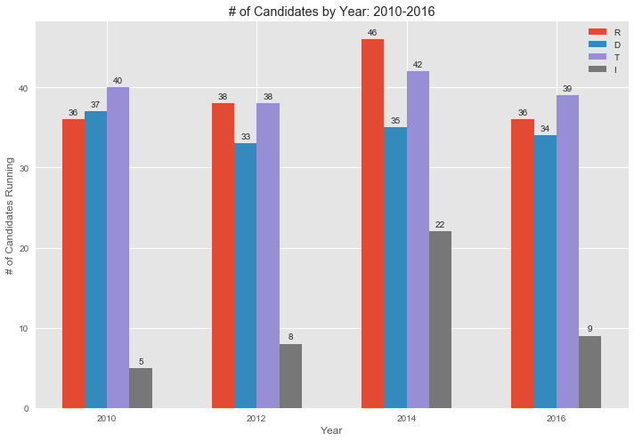
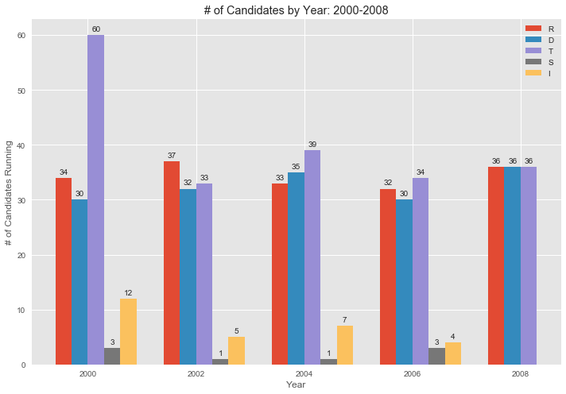
The Dataset - Explored
Stiff Competition:
Number of participants
Per party
Trends & Oddities
Party relevance
Notes:
https://www.crummy.com/software/BeautifulSoup/

Slide 5
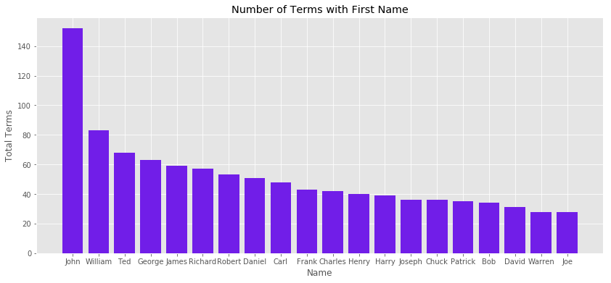
The Dataset - Explored
No surprises:
Traditional names
Barbara was 1st female name
34th most terms (16 appearances)
More potential
Last names?

Slide 6
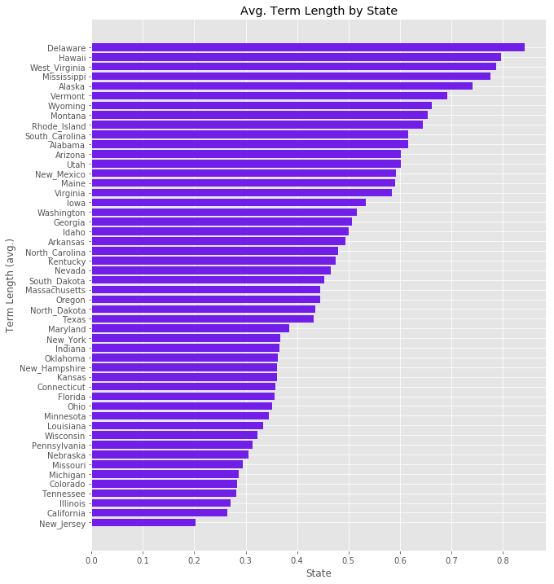
The Dataset - Explored
Big surprises:
Accounts for all candidates each year
Higher number means:
Little to no competition
More consecutive terms
Vice-versa

Slide 7
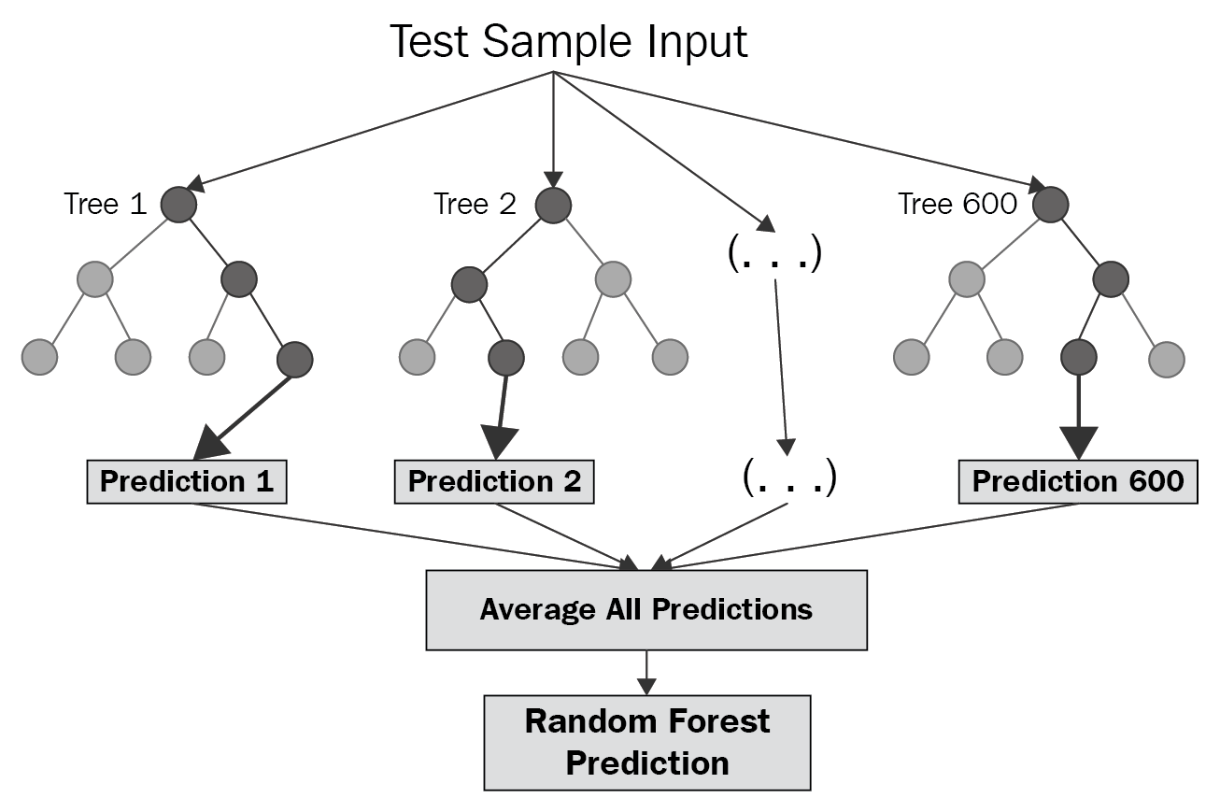
Modeling Process
What:
Linear regression
Predict the percentage of votes
Random Forest from Sci-Kit Learn
‘Decision trees’
How:
Learns from training data
‘Make decisions’ based on learned underlying patterns
Predict using unseen data

Slide 8
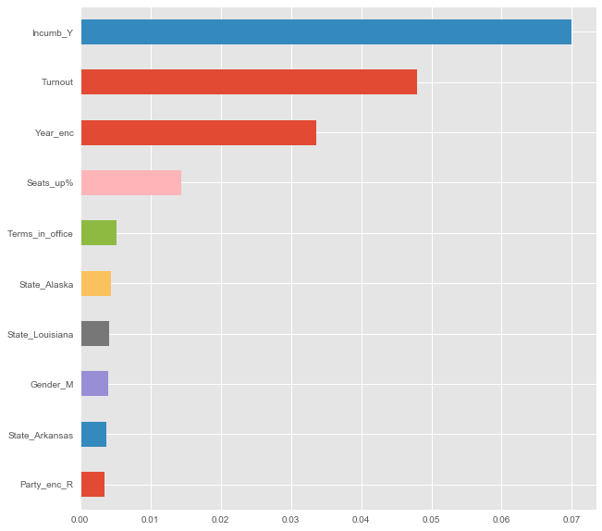
Results
Feature Importance:
Represents the weight each feature has
Does not indicate direction
Relative sense
Seats_before% = 0.75
Top 10 (w/o #1 feature)
Insights:
Timing is critical
Prior year is most important
Experience is crucial
Party does matter
Notes:
“No other parties in the top 20” “assumptions: D, Woman, Alabama”

Slide 9
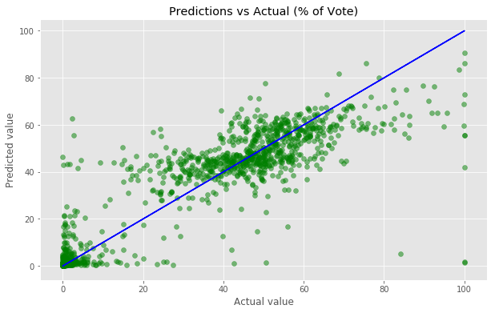
Results
Model Performance:
Root Mean Squared Error (RMSE)
Best model
RMSE = 10.863349
% of votes
Observations:
‘Mirrored’ low end
Bottom-heavy upper bound
Strong cluster in center

Slide 10
Recommendations
Controllable:
Decide to be either Democratic or Republican
Being different doesn’t help
Get Out the Vote (GOTV)
May be party dependent
Incumbency is key
Environmental:
Last cycle’s performance sets the tone
Ride the wave
State elections, national stage
Notes:
Being an incumbent senator is the most important thing a candidate can personally bring into an election. If they are not an incumbent, the information I found in my EDA shows that without this distinguishment, on average you would receive 50% less of the total vote than if you did.

Slide 11
Future Works
More Data:
Cycles happen every 2 years
Take some time
Increase breadth of features
More controllable variables
Age, birthplace, number of attempts, military service, etc.
Building Bigger:
Implement model to predict state elections
Given a set of candidates
Aggregate on a national level

Slide 12

Thank You!
Image copyright: © 2014 Richard F. Ebert All Rights Reserved

